Slide 1
Information Gathering

Slide 2
3. INDIVIDUAL INFORMATION GATHERING
Information about a specific person which can be of any location.
Multiple tools.

Slide 3
Information Gathering- Google
Google is an Attacker's Ally
Lot of information freely available via Internet on public platform
Personal information on company website or a social media site, that give hints to user account password.
Names can be entered in a search engine to reveal home addresses and telephone numbers.

Slide 4
Google Hacking
Using Google as a Reconnaissance Tool
“Google is in many ways (the) most dangerous website on the Internet….”
-Scott Granneman, SecurityFocus

Slide 5
Information Gathering- Google
Human Specific -
Networking Websites
Social Networking Websites
Fake Surveys
Spy Services
Twitter
Facebook
Dating Websites
Matrimonial Websites
Linkedin
Job Portals

Slide 6
Other ways of Information Gathering
Social Networking Sites
Smart Applications
Online Portals
Some fake emails
Some Tools
Facebook , Instagram, twitter, Gmail+, linkedin etc.
TRuecaller , Hackode etc.
Shaadi.com , Naukri.com, Shine.com, Indeed.com, jantakhoj.com, pipl etc.
https://temp-mail.org/ , https://www.guerrillamail.com/inbox
Maltego , HTTrack- Website Copier etc
zabasearch.com
names, addresses, phone numbers, date of birth,
Phone book offering forward and reverse lookups
anywho.com

Slide 7
Google DORKS
https://merabheja.com/tech-hacks/ (amazing hacks)

Slide 8
Google Dorks
Google Dork
Use Google Dorks
is a search string that uses advanced search operators to find information that is not readily available on a website.
To find vulnerabilities, hidden information and access pages on certain websites.

Slide 9
Google Dorks
Search keywords in title, URL and text
Blue or purple-Title of Web page
Green-URL of web page
Black-text of the web page
To search only in any one of them, is google dorks which optimizes the search

Slide 10
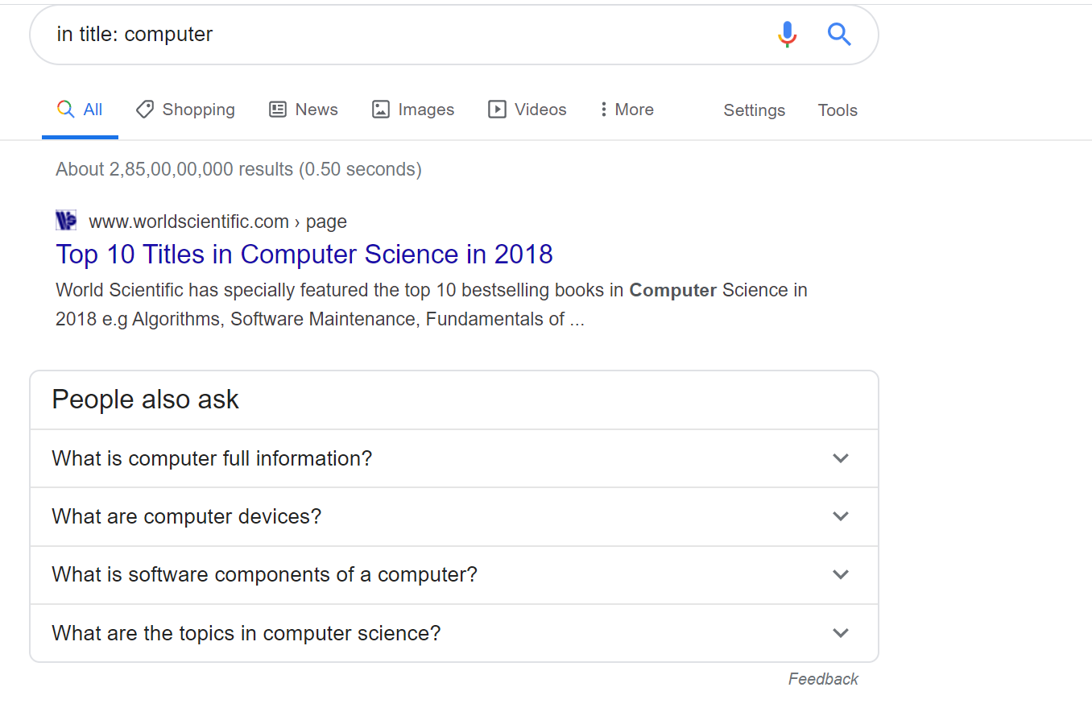
Optimized Search through google dorks
Search For keywords in Title (keyword should exist in title)
Intitle: computer
It will give all results in which title
Is computer

Slide 11
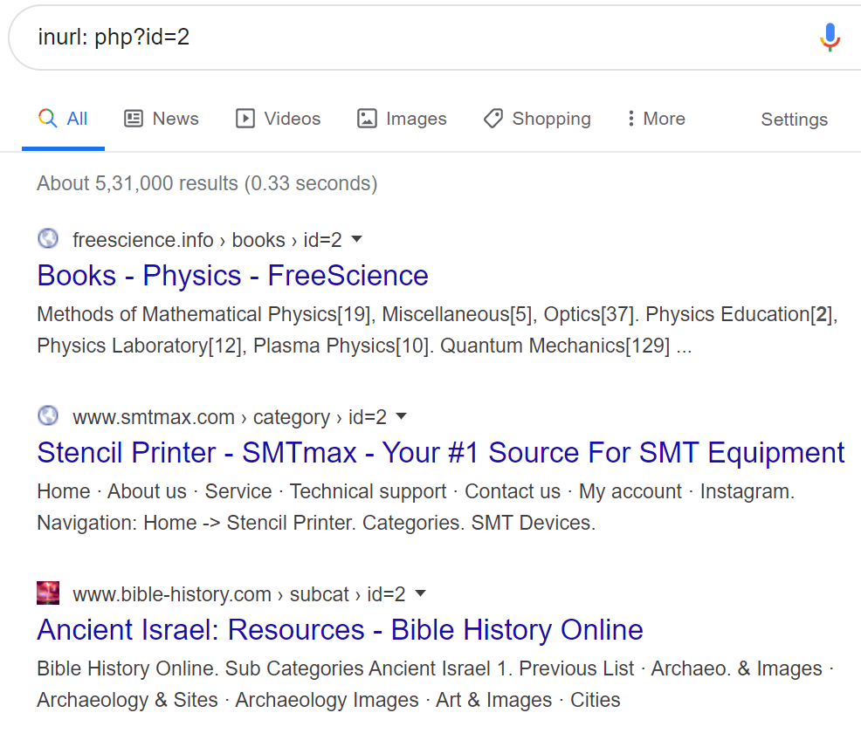
Optimized Search through google dorks
2. Search For keywords in URL (keyword should exist in URL)
Inurl : php?id=2
Inurl : admin
Inurl : admin.pk
It will give all results in which URL
has keyword

Slide 12
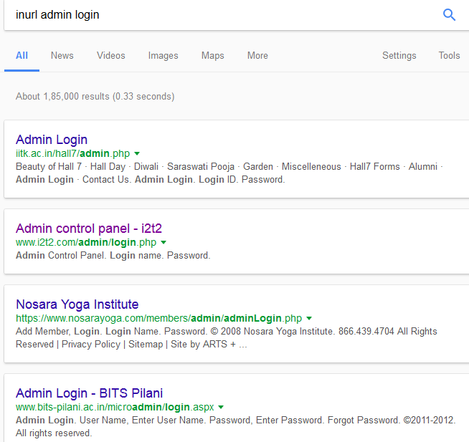
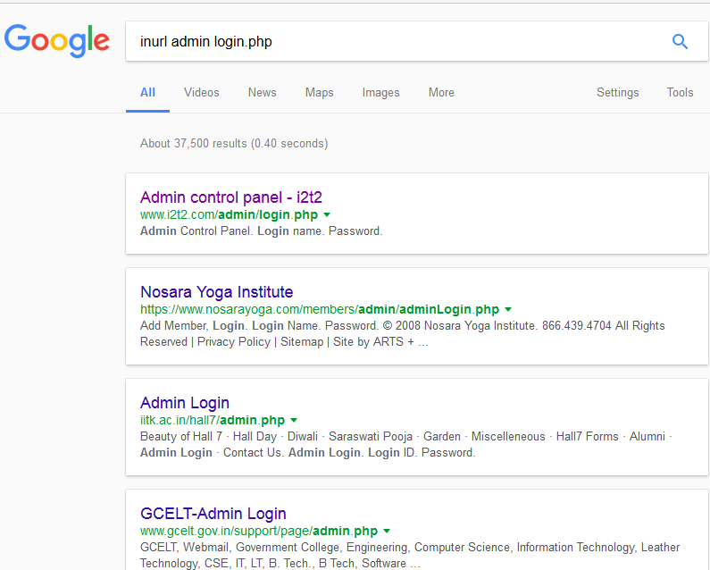
Optimized Search through google dorks
2. Search For keywords in URL (keyword should exist in URL)
Inurl : admin login

Slide 13
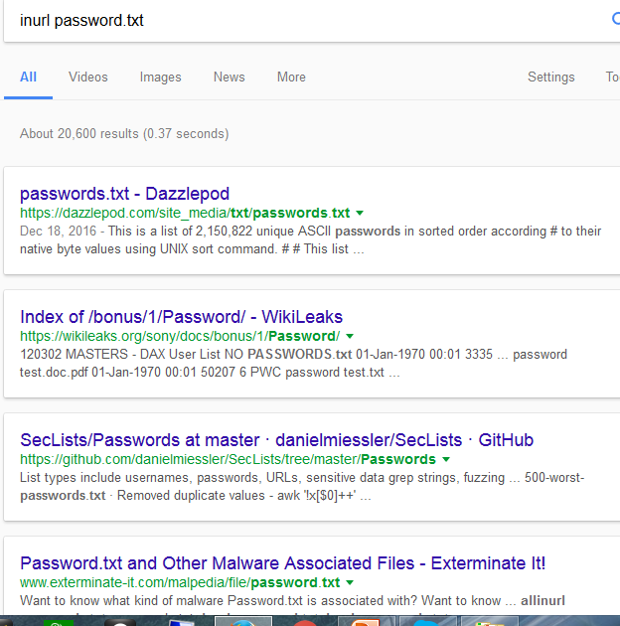
Optimized Search through google dorks
2. Search For keywords in URL (keyword should exist in URL)
Inurl : password

Slide 14
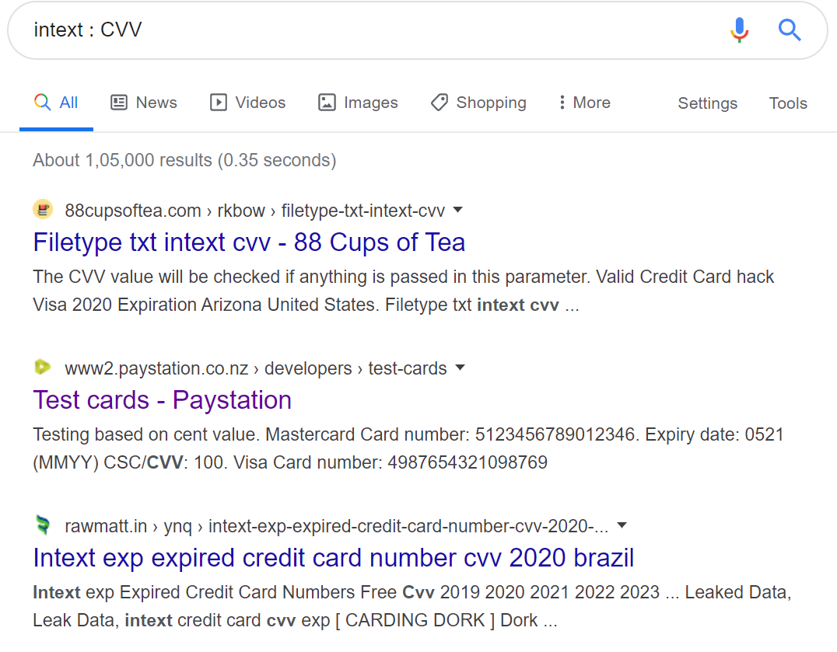
Optimized Search through google dorks
3. Search For keywords in text (keyword should exist in URL)
Intext : CVV
It will give all results in which text
has keyword

Slide 15
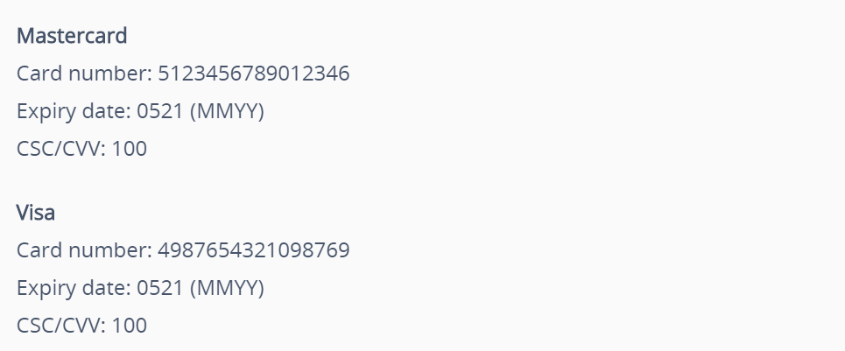
Optimized Search through google dorks
3. Search For keywords in text (keyword should exist in URL)
Intext : CVV
Open any link and you will find card details

Slide 16
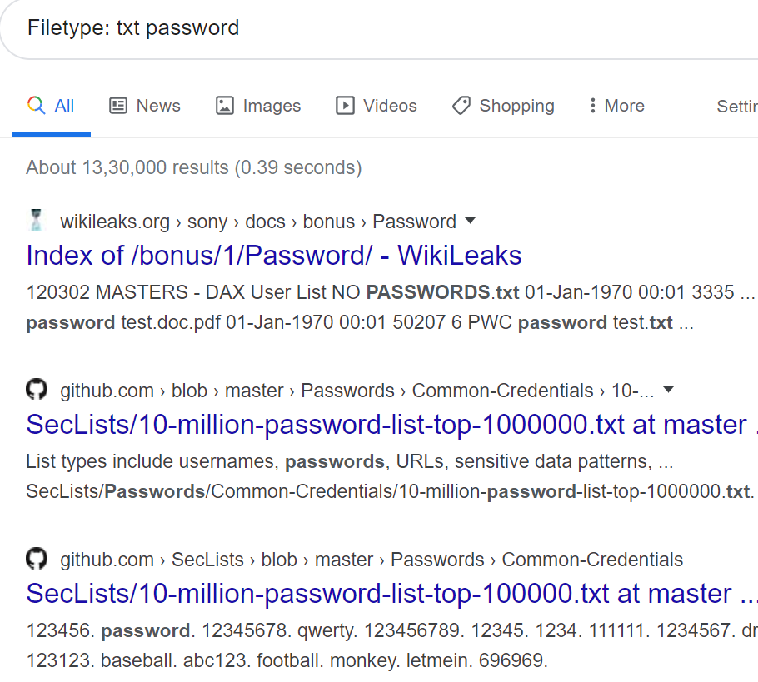
Optimized Search through google dorks
On servers there are some files where one of the file is password.txt.
We can find these files using optimized method
4. Search For file with specific type of extension
Filetype: txt password
Filetype:pdf

Slide 17
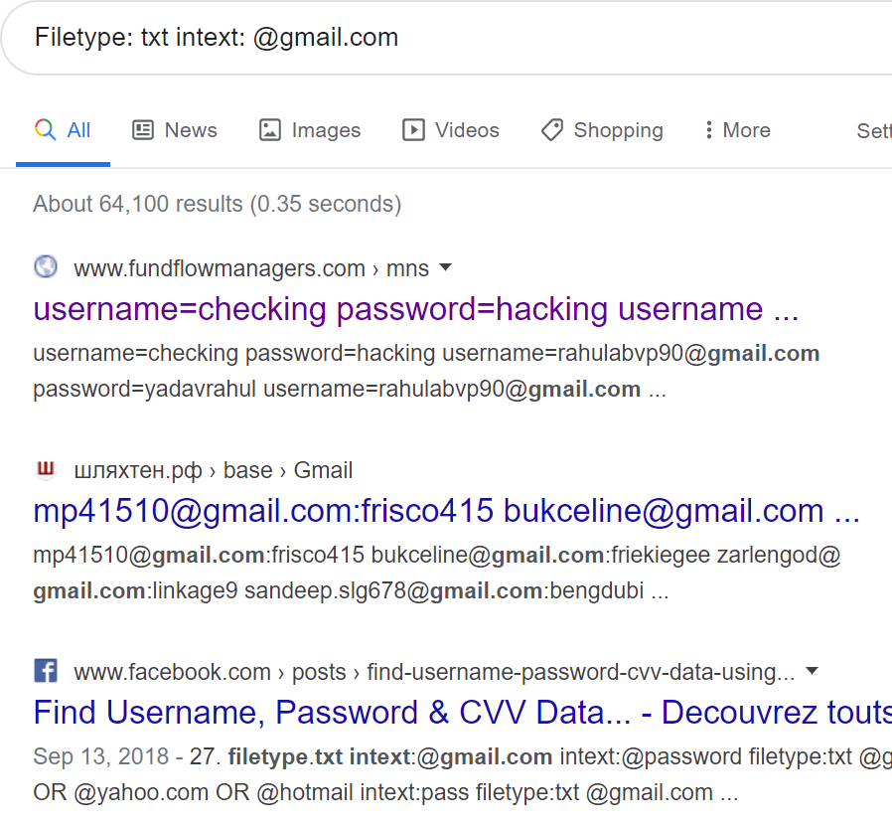
Optimized Search through google dorks
We can use multiple dorks together
5. Search For file with specific type of
extension in specific dorks
Filetype: txt intext: @gmail.com
inurl:.gov.pk intitle: login/admin

Slide 18
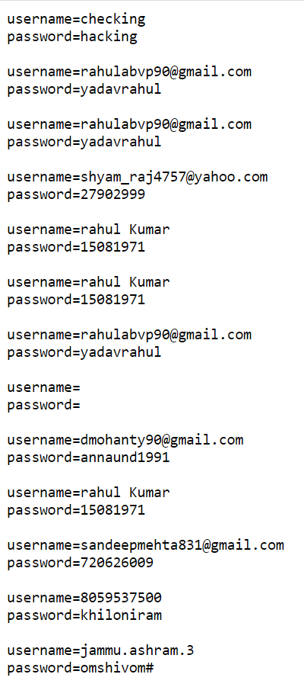
Optimized Search through google dorks
5. Search For file with specific type of
extension in specific dorks
Open any link you will find details of
username and password text file

Slide 19
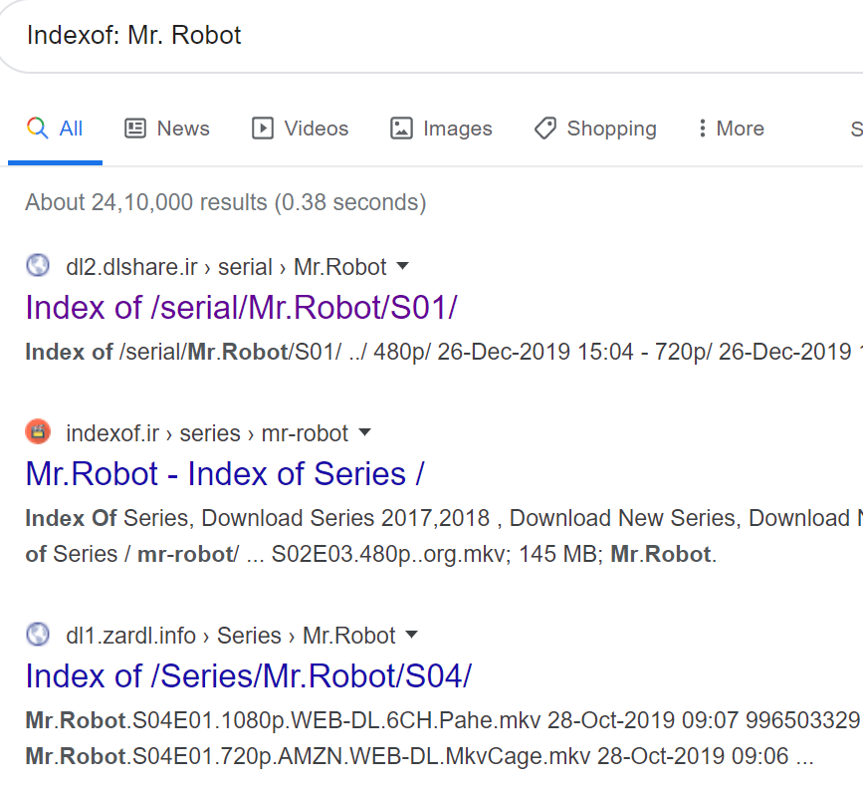
Optimized Search through google dorks
6. Search For keywords in directories
Indexof: Mr. Robot
Search the directories quickly
Each website has been indexed by
google

Slide 20
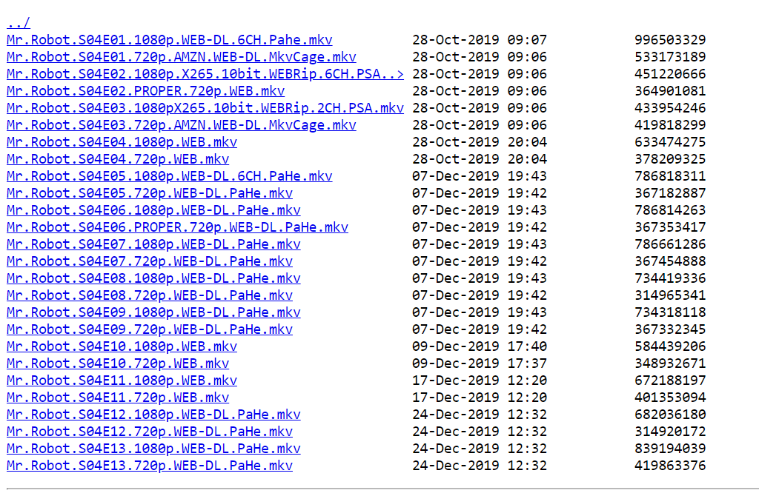
Optimized Search through google dorks

Slide 21
Optimized Search through google dorks
6. Search For keywords in directories
Indexof: Movie
If http is blocked in an organization or on your system you can imbed https in front of link.
Why it works?
Because govt has blocked port 80, not 443.
What is the solution?
Govt should have blocked domain instead.

Slide 22
Examples

Slide 23
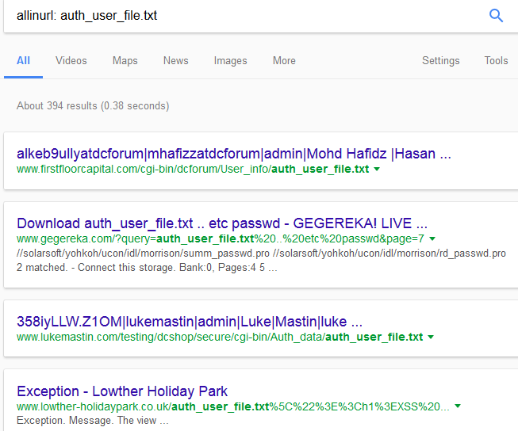
Example: allinurl

Slide 24
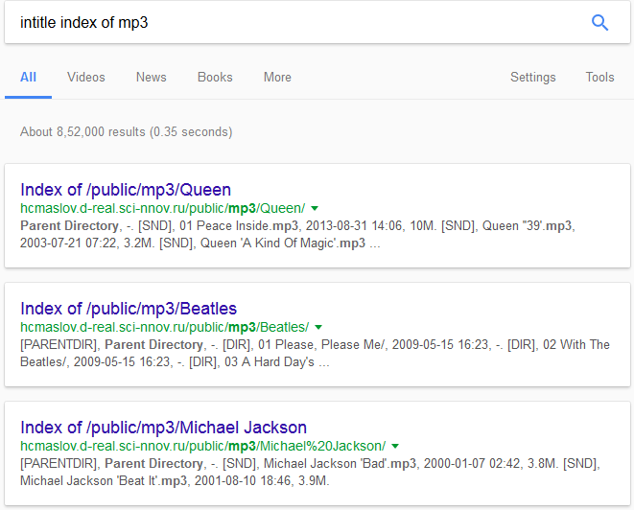
Examples: intitle search

Slide 25
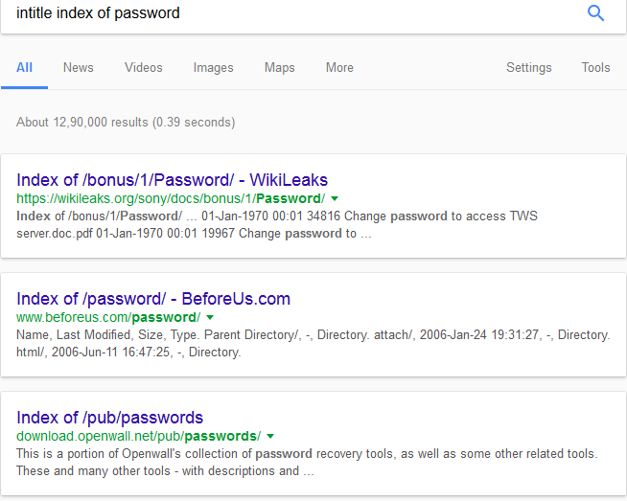
Examples: intitle search

Slide 26
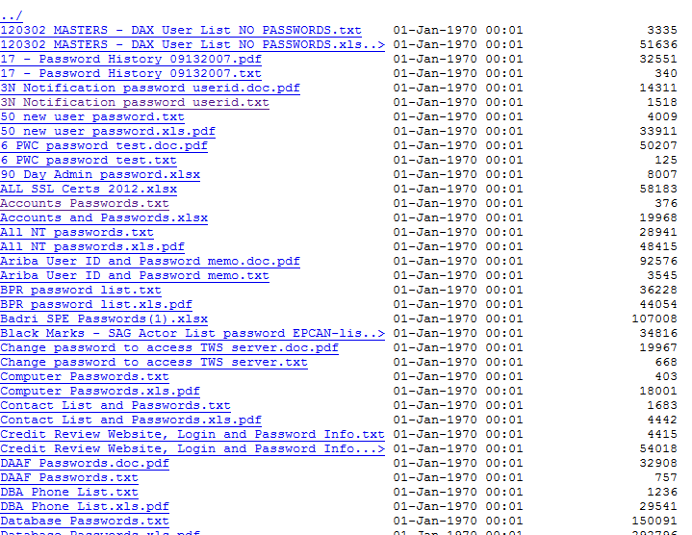
Examples: intitle search

Slide 27
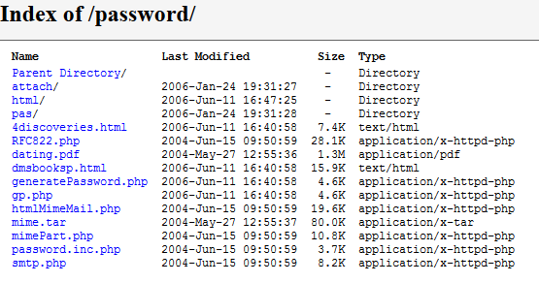
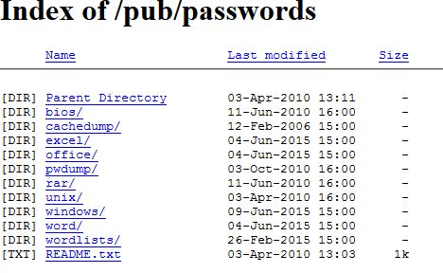
Examples: indexof search

Slide 28
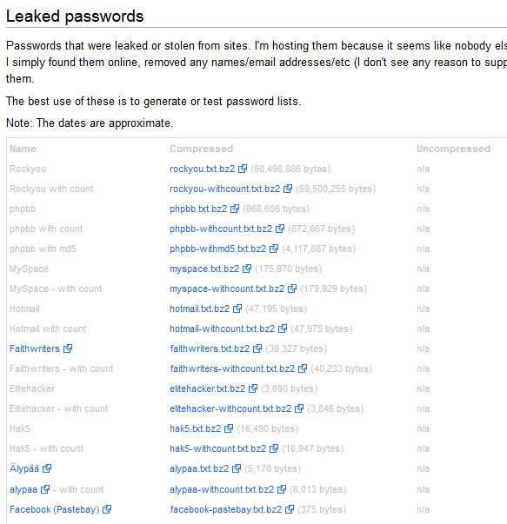
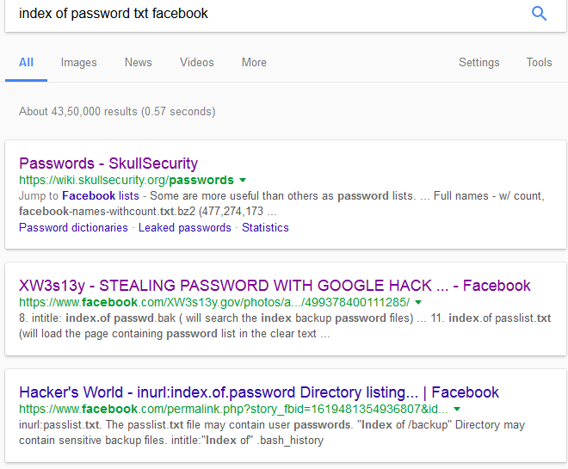
Examples: indexof search

Slide 29
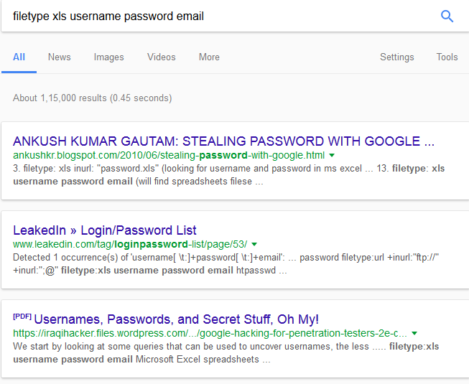
Examples: filetype search

Slide 30
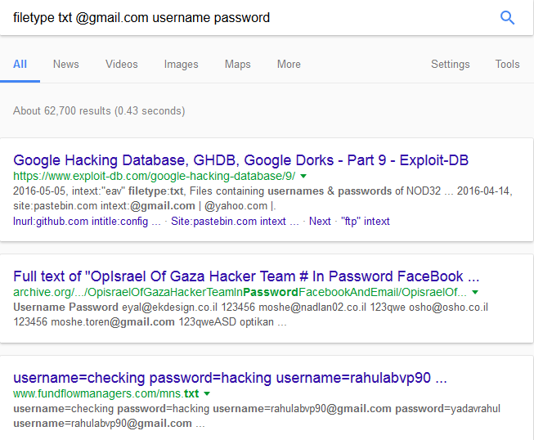
Examples: filetype search

Slide 31
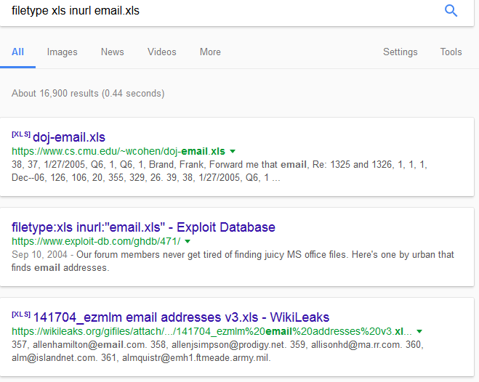
Examples: filetype and inurl search

Slide 32
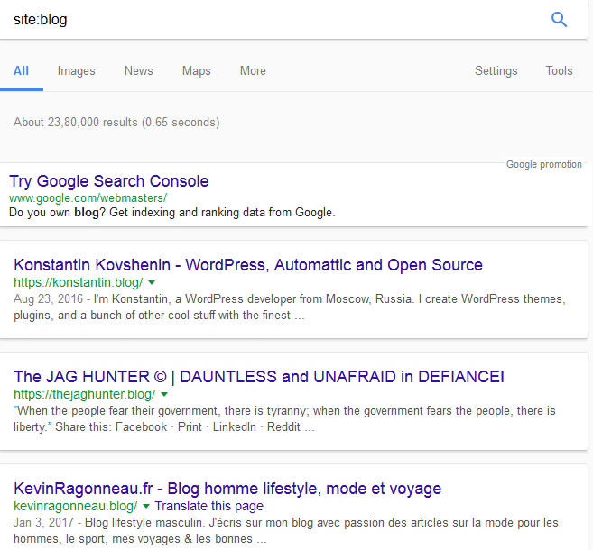
Examples: site search

Slide 33
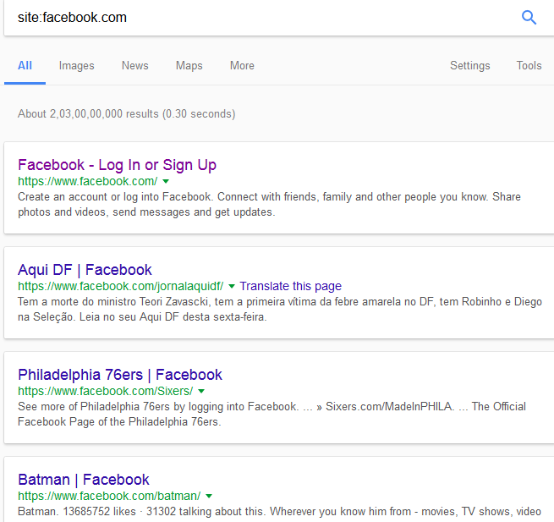
Examples: site search

Slide 34
Google crawl for password search
Here, some google search syntax to crawl the password: 1. "Login: *" "password =*" filetype: xls (searching data command to the system files that are stored in Microsoft Excel) 2. allinurl: auth_user_file.txt (to find files auth_user_file.txt containing password on server). 3. filetype: xls inurl: "password.xls" (looking for username and password in ms excel format). This command can change with admin.xls) 4. intitle: login password (get link to the login page with the login words on the title and password words anywhere. If you want to the query index more pages, type allintitle) 5. intitle: "Index of" master.passwd (index the master password page) 6. index of / backup (will search the index backup file on server) 7. intitle: index.of people.lst (will find web pages that contain user list). 8. intitle: index.of passwd.bak ( will search the index backup password files)

Slide 35
Information Gather-Cameras Info
Camera’s can also be seen because they also have title and google crawls
It also have list of webcams
They are browsed through internet & google might have crawled.
Webcam access google dorks list (search on google)
Exploit-db.com
It will give no. of exploits of Cam
Intitle: Live/-Axis
Intitle:/view.shtml
Web Cam View

Slide 36
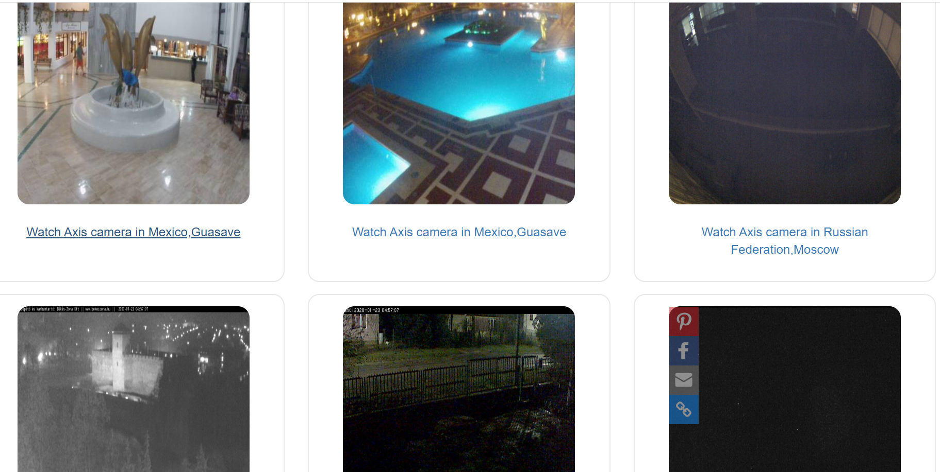
Information Gathering-Camera’s
Intitle: Live/-Axis
Open any link
https://www.insecam.org/en/bytype/Axis/

Slide 37
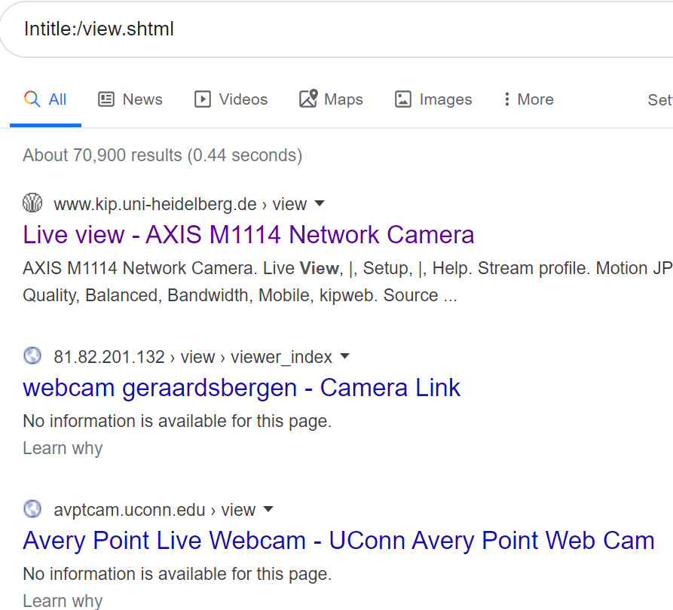
Information Gathering-Camera’s
Intitle:/view.shtml

Slide 38
Information Gathering-Camera’s
Search for your own webcam
IP:Port on google
Shodan.io
Just Dont Try to exploit any military camera if you just come across them.
Also gives port for web cams

Slide 39
Google Dork List to find cameras
Inurl:”CgiStart?page=”
inurl:/view.shtml
intitle:”Live View / – AXIS
inurl:view/view.shtml
inurl:ViewerFrame?Mode=
inurl:ViewerFrame?Mode=Refresh
inurl:axis-cgi/jpg
inurl:axis-cgi/mjpg (motion-JPEG) (disconnected)
inurl:view/indexFrame.shtml
inurl:view/index.shtml
inurl:view/view.shtml
liveapplet
intitle:”live view” intitle:axis
intitle:liveapplet
allintitle:”Network Camera NetworkCamera” (disconnected)
intitle:axis intitle:”video server”
intitle:liveapplet inurl:LvAppl
intitle:”EvoCam” inurl:”webcam.html”
intitle:”Live NetSnap Cam-Server feed”
intitle:”Live View / – AXIS”
inurl:indexFrame.shtml Axis

Slide 40
Digital Footpriniting
When some traces and tracks are left or "footprints" of ourselves while using some internet services
Can be transmitted online, such as forum registration, e-mails , uploading videos or digital images etc.

